Slide 1
UNIT 1
Introduction: Uses of Computer Networks, Types of networks: WAN, LAN, MAN, Network Topologies, Reference models: OSI, TCP/IP.
Physical Layer: Transmission media, magnetic media, twisted pair, coaxial cable, fiber optics, wireless transmissions.

Slide 2
Introduction
Scope of Computer Networks- Networking is everywhere.
networking for communication
Networking for learning
Networking for gaming
Networking for working

Slide 3
Uses of Computer Network
Business Application
Home Application
Mobile Users
Social Issues

Slide 4
Type of Networks
Network Category depends on its size
Primary categories
LAN: Covers area < 2miles
WAN: Can be worldwide
MAN: Between LAN & WAN, span 10s of miles

Slide 5
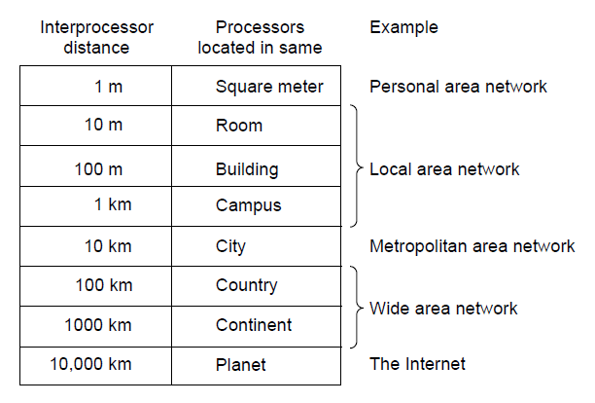
Classification of interconnected processors by scale.

Slide 6
Local Area Network (LAN)
Privately owned
Restricted in size
Links devices in the same office, building, or campus
Simple LAN: 2 PCs & 1 printer in home or office
Size is limited to a few kilometers
Allow resources to be shared (hardware, software, or data)

Slide 7
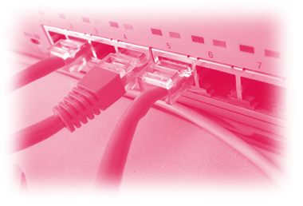
Local Area Network (LAN)
LAN is distinguished by:
Size
Transmission medium (only one type)
Topology (bus, ring, star)
Data Rates (speed):
Early: 10 to 100 Mbps
Today:10Gbps

Slide 8
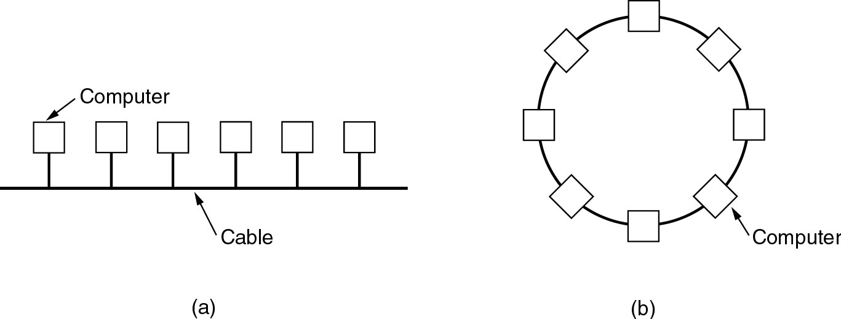
Local Area Networks
Two broadcast networks
(a) Bus
(b) Ring

Slide 9
Figure 2-16
Local Area Network
WCB/McGraw-Hill
© The McGraw-Hill Companies, Inc., 1998

Slide 10
Figure 2-16-continued
Local Area Network
WCB/McGraw-Hill
© The McGraw-Hill Companies, Inc., 1998

Slide 11
Metropolitan Area Networks (MAN)
Size between LAN and WAN
Inside a town or a city
Owned by a private or public company
Example: Cable television network

Slide 12
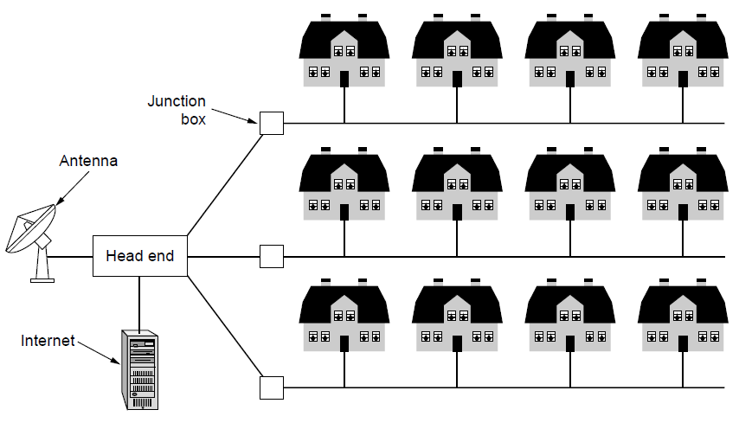
A metropolitan area network based on cable TV.

Slide 13
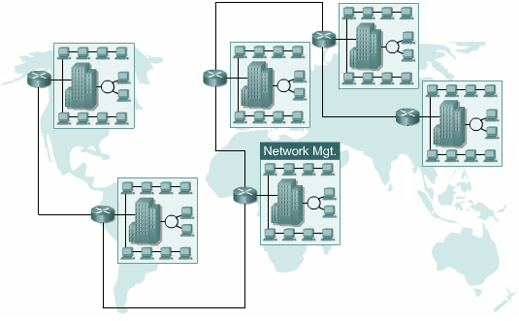
Wide Area Networks (WAN)
Provides long-distance transmission of data over large geographic areas (country, continent, world)
Enterprise network: A WAN that is owned and used by one company

Slide 14
Wide Area Networks (WAN)
Network spread geographically is called WAN
WAN contain hosts these are connected by a communication subnet.
The job of the subnet is to carry messages from host to host.
Subnet contains two distinct components
Transmission lines: ( trunks, circuits, or channels)
move bits between machines.
Switching elements:
Specialized computers used to connect three or more transmission lines.

Slide 15
Wide Area Networks (WAN)
Switched WAN
Backbone of the Internet
Dialup line point-to-point WAN
Leased line from a telephone company

Slide 16
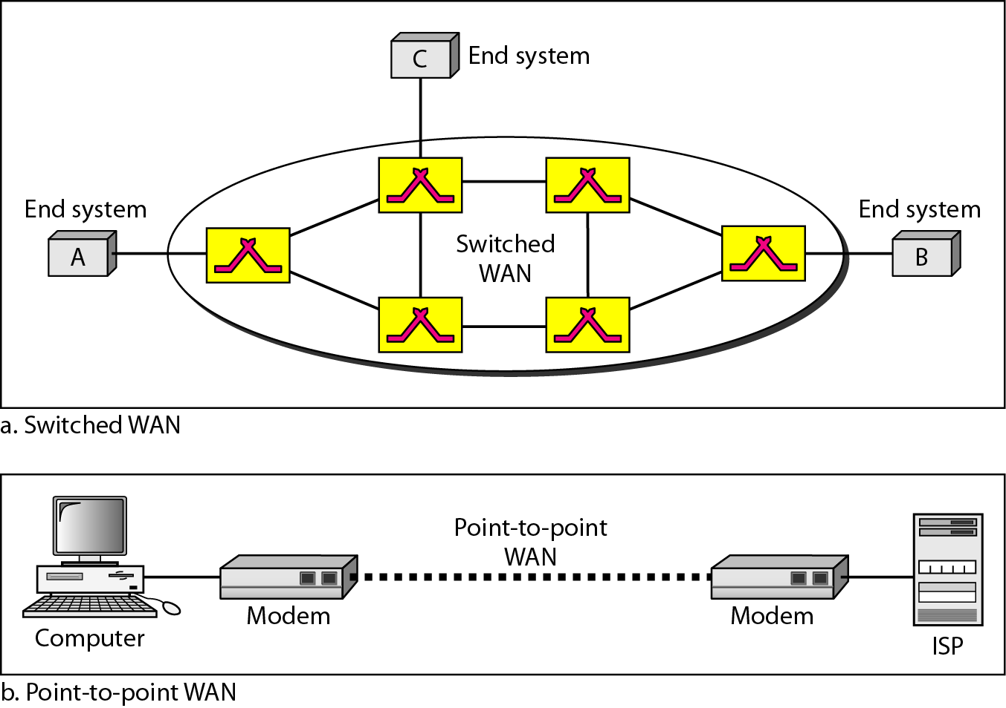
Wide Area Networks (WAN)

Slide 17
Internetwork
(Internet)
Internetwork (Internet ): Two or more networks are connected by internetworking devices
Internetworking devices: routers, gateways etc

Slide 18
Topology
Physical Topology
The way a network is laid out physically
Two or more links form a topology
The topology of a network is the geometric representation of the relationship of all the links and linking devices (nodes) to one another.
Four topologies : Mesh, Star, Bus, and Ring

Slide 19
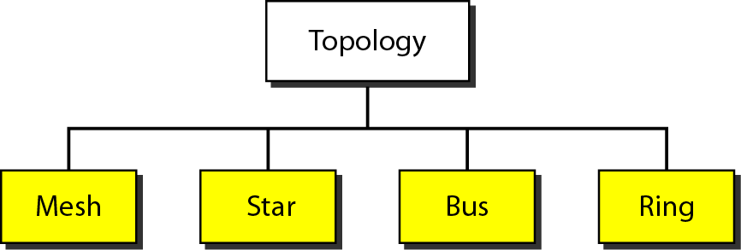
Physical Topology

Slide 20
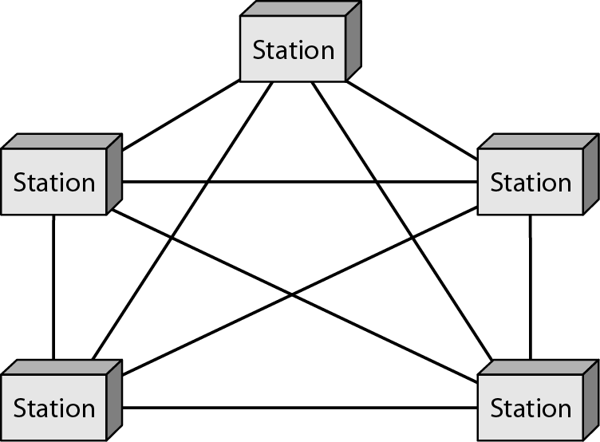
Physical Topology
Mesh
Every link is dedicated point-to-point link
The term dedicated means that the link carries traffic only between the two devices it connects

Slide 21
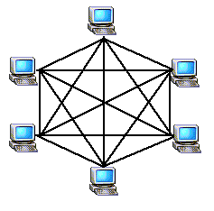
Physical Topology
Mesh
To link n devices fully connected mesh has: n ( n - 1) / 2 physical channels (Full-Duplex)
Every Device on the network must have n - 1 ports

Slide 22

Physical Topology
Mesh
Example:
8 devices in mesh has links: n(n-1) / 2
number of links = 8 (8-1)/2 = 28
number of ports per device = n – 1 = 8 –1 = 7

Slide 23
Physical Topology
Mesh
Advantages
Each connection carry its own data load (no traffic problems)
A mesh topology is robust
Privacy or security
Fault identification and fault isolation

Slide 24
Physical Topology
Mesh:
Disadvantages
Big amount of cabling
Big number of I/O ports
Installation and reconnection are difficult
Sheer bulk of the wiring can be greater than the available space
Hardware connect to each I/O could be expensive
Mesh topology is implemented in a limited fashion; e.g., as backbone of hybrid network

Slide 25
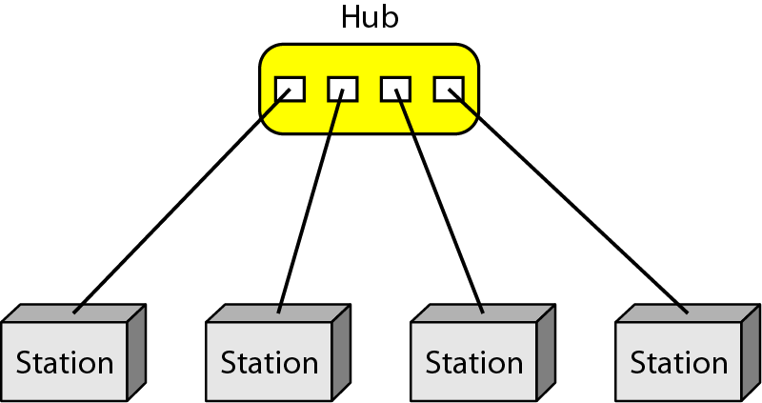
Physical Topology
Star:
Dedicated point-to-point to a central controller (Hub)
No direct traffic between devices
The controller acts as an exchange

Slide 26

Physical Topology
Star
Advantages
Less expensive than mesh (1 Link + 1 port per device)
Easy to install and reconfigure
Less cabling
Additions, moves, and deletions required one connection
Robustness : one fail does not affect others
Easy fault identification and fault isolation

Slide 27
Physical Topology
Star
Disadvantages
Dependency of the whole topology on one single point (hub)
More cabling than other topologies ( ring or bus)
Used in LAN

Slide 28
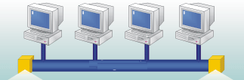
Physical Topology
Bus
It is multipoint
One long cable acts as a backbone

Slide 29
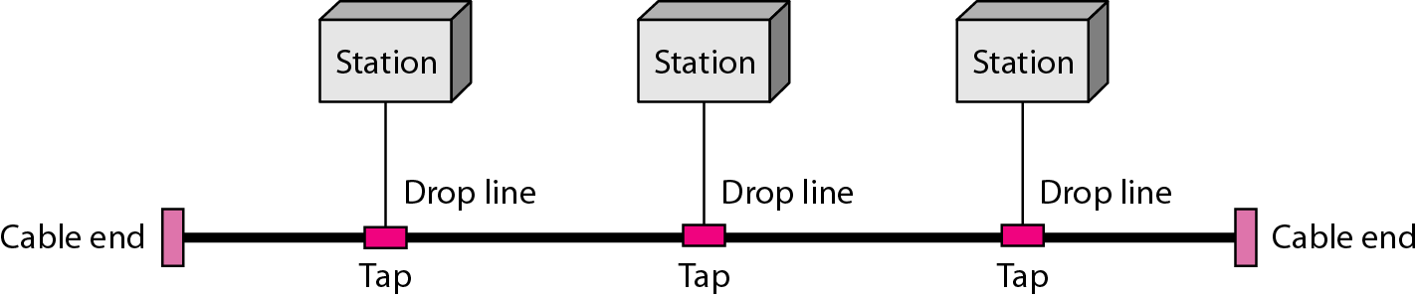
Physical Topology
Bus
Nodes connect to cable by drop lines and taps
Signal travels along the backbone and some of its energy is transformed to heat
Limit of number of taps and the distance between taps

Slide 30

Physical Topology
Bus
Advantages
Ease of installation
Less cables than mesh, star topologies
Disadvantages
Difficult reconnection and fault isolation ( limit of taps)
Adding new device requires modification of backbone
Fault or break stops all transmission
The damaged area reflects signals back in the direction of the origin, creating noise in both directions

Slide 31
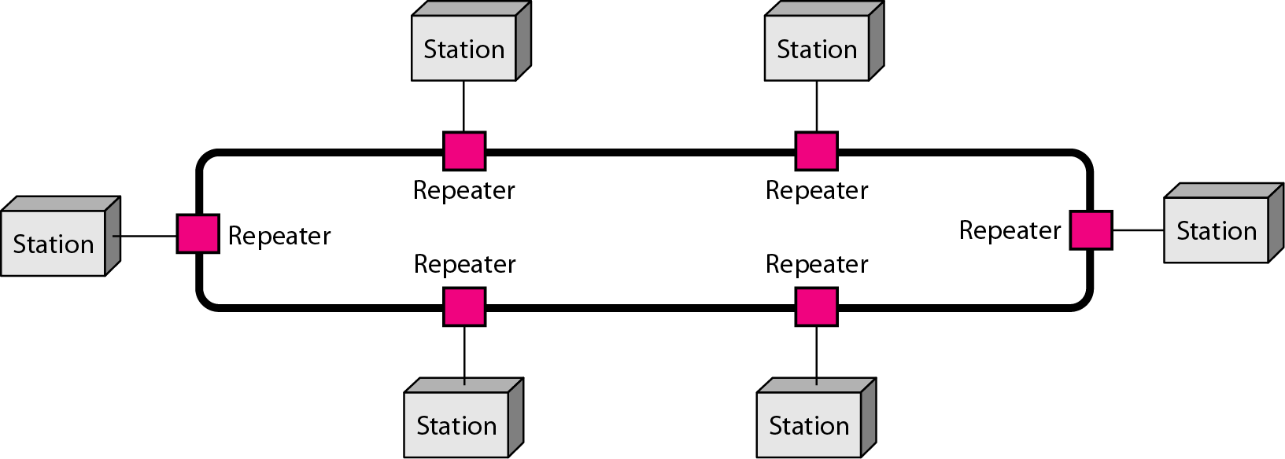
Physical Topology
Ring
Each device has dedicated point-to-point connection with only the two devices on either side of it
A signal is passed along the ring in one direction from device to device until it reaches its destination
Each devices incorporates a Repeater

Slide 32

Physical Topology
Ring
Advantages
Easy to install and reconfigure
Connect to immediate neighbors
Move two connections for any moving (Add/Delete)
Easy of fault isolation
Disadvantage
Unidirectional
One broken device can disable the entire network. This weakness can be solved by using a dual ring or a switch capable of closing off the break

Slide 33
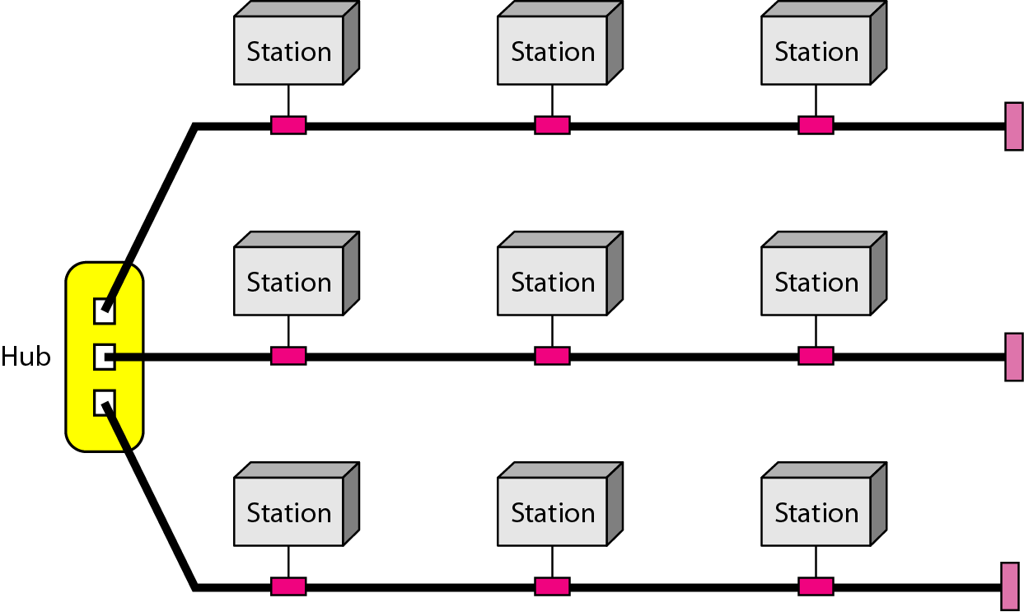
Physical Topology
Hybrid Topology
Example: having a main star topology with each branch connecting several stations in a bus topology

Slide 34
Figure 2-10
Hybrid Topology
WCB/McGraw-Hill
© The McGraw-Hill Companies, Inc., 1998

Slide 35
The OSI Model
Open Systems Interconnection (OSI).
Developed by the International Organization for Standardization (ISO).
Model for understanding and developing computer-to-computer communication.
It is not a protocol.
Developed in the 1980s.
Divides network architecture into seven layers.

Slide 36
The OSI Reference Model
Principles
A layer should be created where a different level of abstraction is needed.
Each layer should perform a well defined function.
The function of each layer should be chosen with an eye toward defining internationally standardized protocols.
The layer boundaries should be chosen to minimize the information flow across the interfaces.
The number of layers should be large enough that distinct functions need not be thrown together in the same layer out of necessity, and small enough that the architecture does not become unwieldy.

Slide 37
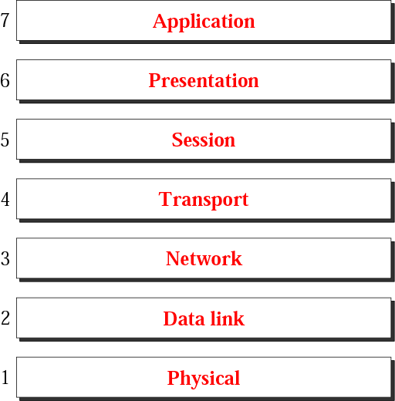
OSI Layers
Mnemonic- Please Do Not Throw Sausage Pizza Away

Slide 38
OSI Layering
Changes in one layer should not require changes in other layers
Each layer performs a subset of functions that is required by communication
Each layer relies on the next lower layer to perform more primitive functions
Each layer provides services to the next higher layer
Layer 1,2,3 are the network support layer, deals with the physical aspects of moving data from one device to another.
Layer 5,6,7 are the user support layer, allow the interoperability among unrelated software.

Slide 39
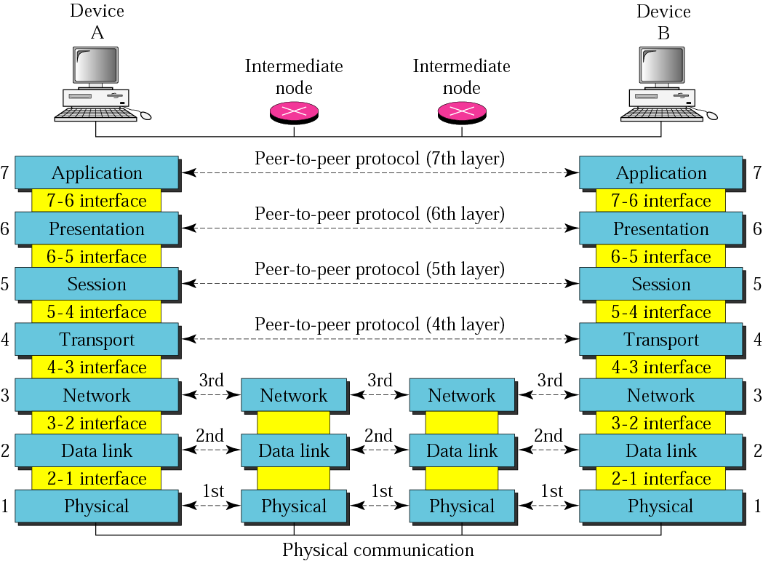
OSI layer

Slide 40
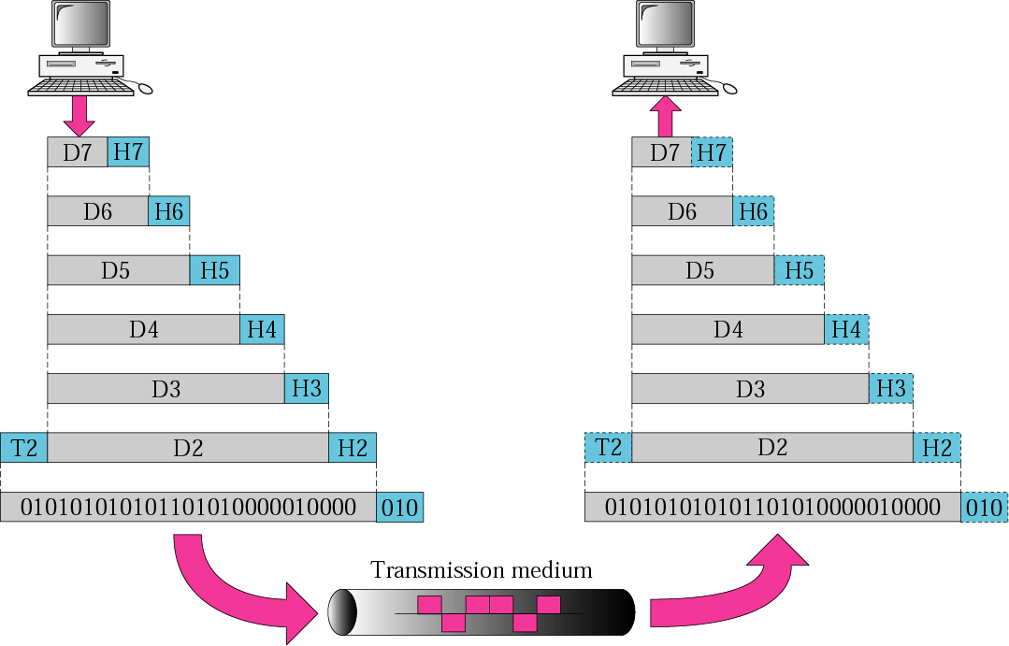
An exchange using the OSI model

Slide 41
Physical layer
defines the procedures and functions that physical devices and interfaces have to perform for transmission occur.
The physical layer is concerned with the following:
Physical characteristics of interfaces and media
Representation of the bits
Data rate, the number of bits sent each second.
Line configuration, Point to point or multipoint configuration.
Physical topology
Transmission Mode : Simplex, half duplex or full duplex

Slide 42
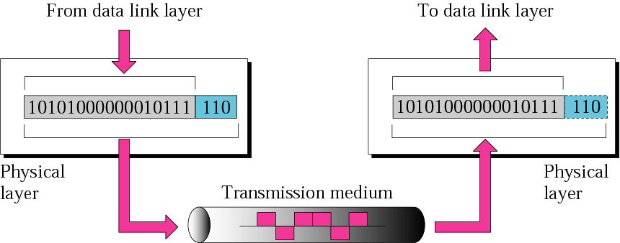
Physical Layer cont.

Slide 43
Data Link Layer
The data link layer is responsible for moving frames from one hop (node) to the next, So it is responsible for node-to-node delivery.
The Data Link layer is concerned with the following:
Framing.
Physical addressing, each node has its unique address.
Flow Control.
Access Control.
Error control, normally achieved through a trailer to the end of the frame.

Slide 44
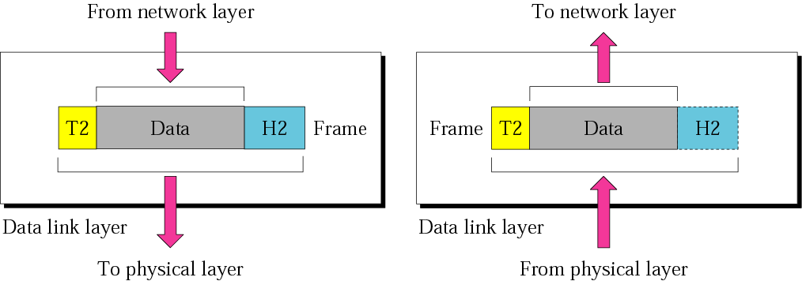
Data Link layer cont.
10110110101
01100010011
10110000001

Slide 45
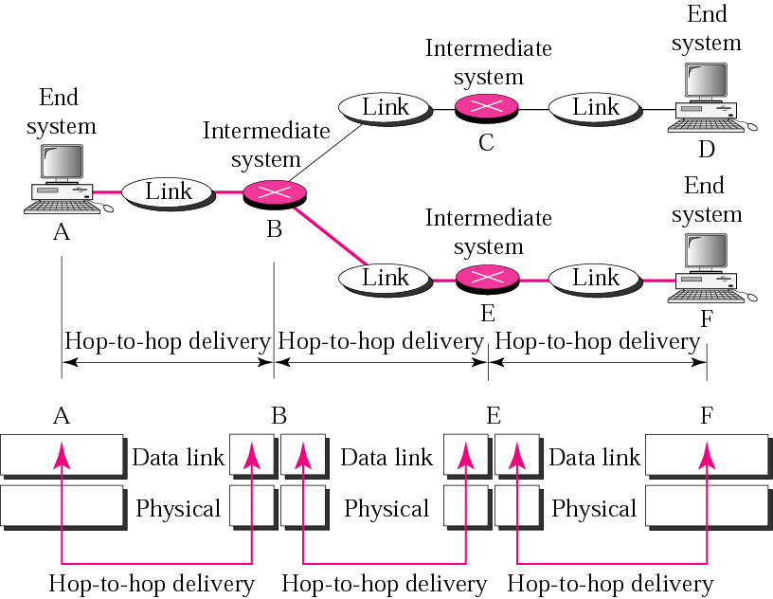
Hop-to-Hop delivery

Slide 46
Network Layer
Is responsible for the source-to-destination delivery of a packet possible across multiple networks.
Functions:
Logical addressing- The physical addressing implemented by the data link layer handles the addressing problem locally. This is not enough when the data is send across multiple networks.
Routing, It determines which path the data should take based on network conditions, priority of service, and other factors.

Slide 47
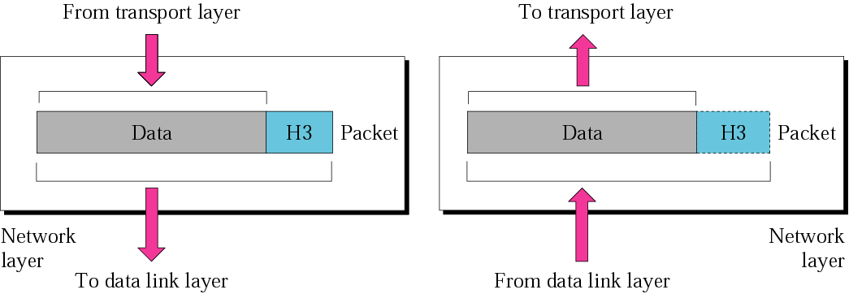
Network Layer cont.

Slide 48
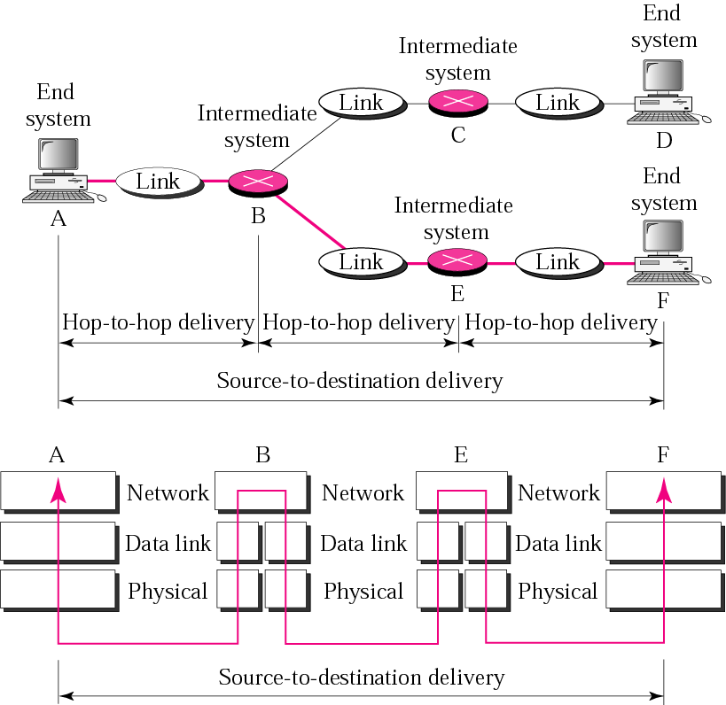
Source-to-Destination delivery

Slide 49
Transport Layer
The transport layer is responsible for process-to-process delivery of the entire message.
Functions:
Port addressing, The network layer gets each packet to the correct computer; the transport layer gets the entire message to the correct process on that computer.
Segmentation and reassembly: a message is divided into transmittable segments, each having a sequence number
Connection control: The transport layer can be either connectionless or connection-oriented.
Flow control
Error control
Notes:
A connectionless transport layer treats each segment as an independent packet and delivers it to the transport layer at the destination machine.
A connection-oriented transport layer makes a connection with the transport layer at the destination machine first before delivering the packets. After all the data are transferred, the connection is terminated.

Slide 50
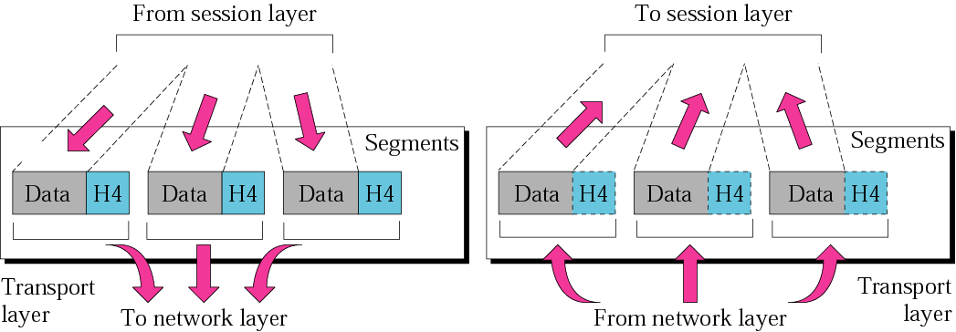
Transport Layer cont.

Slide 51
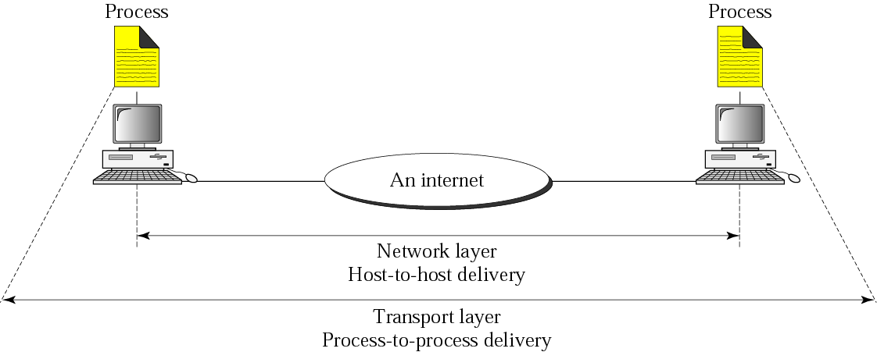
Reliable process-to-process delivery of a message

Slide 52
Session Layer
the session layer, allows two applications on different computers to open, use, and close a connection
(A session is a highly structured dialog between two workstations.)
Functions:
Dialog control
It also makes sure the session is orderly, establishing which node transmits first, how long it can transmit, and what to do in case of an error.
Synchronization
The session layer synchronizes user tasks by placing checkpoints in the data stream.

Slide 53
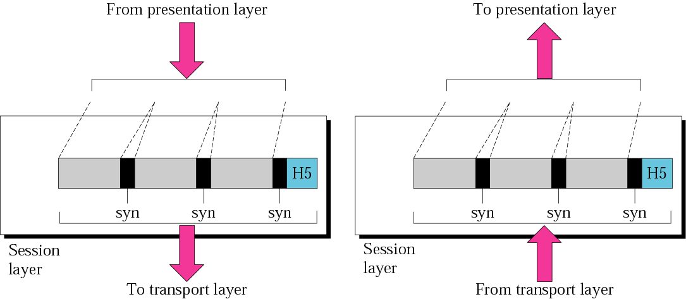
Session Layer cont.

Slide 54
Presentation layer
The presentation layer is responsible for translation, compression, and encryption.
Translation
The presentation layer at the sender changes the information from sender dependent format into common format. The presentation layer in the receiver changes the format into receiver dependent format.
Encryption
Encryption means that the sender transforms the original information to another form. Decryption reverses the original process to transform the message to its original form.
Compression
Data compression reduces the number of bits contained in the information.

Slide 55
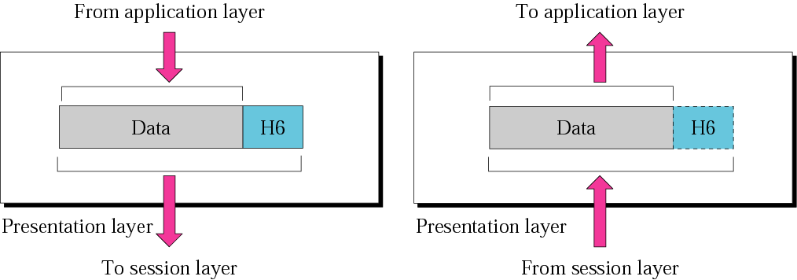
Presentation Layer cont.

Slide 56
Application Layer
Application layer interacts with application programs.
Examples of application layer are applications such as file transfer, electronic mail, remote login etc.

Slide 57
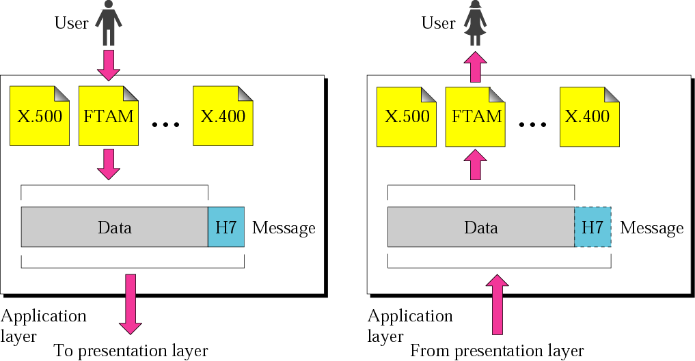
Application Layer cont.
SMTP
Telnet
HTTP
SMTP
Telnet
HTTP

Slide 58
2-4 TCP/IP PROTOCOL SUITE
The layers in the TCP/IP protocol suite do not exactly match those in the OSI model.
The original TCP/IP protocol suite was defined as having four layers: host-to-network, internet, transport, and application.
When TCP/IP is compared to OSI, we can say that the TCP/IP protocol suite is made of five layers: physical, data link, network, transport, and application.

Slide 59
The Layers in the TCP/IP Protocol Suite
Source: The TCP/IP Protocol Suite, Behrouz A. Forouzan
Application
FTP
HTTP
DNS
NFS
…
Presentation
Session
Transport
TCP
UDP
IP
ICMP
IGMP
Network
ARP
RARP
Data link
Physical
Figure 2.16 TCP/IP and OSI model

Slide 60
2-4 TCP/IP PROTOCOL SUITE
TCP/IP is a hierarchical protocol made up of interactive modules, each of which provides a specific functionality.
The layers of the TCP/IP protocol suite contain relatively independent protocols.
The term hierarchical means that each upper-level protocol is supported by one or more lower-level protocols.

Slide 61
2-4 TCP/IP PROTOCOL SUITE
Physical and Data Link Layers
No specific protocol is defined at this layer, rather, TCP/IP model supports all the standard and proprietary protocols.
For instance, a network in a TCP/IP internetwork can be a local-area network or a wide-area network.

Slide 62
2-4 TCP/IP PROTOCOL SUITE
Network layer (internetwork layer)
TCP/IP at this layer supports the Internetworking Protocol (IP)
There are also some other protocols that support data movement in this layer. Including: ARP, RARP, ICMP, and IGMP.

Slide 63
Protocols at The Network Layer
Internetworking Protocol (IP)
Most important protocol of the TCP/IP network stack!
Implements internetworking.
IP is an unreliable and connectionless protocol- a best-effort delivery.
It is host-to-host protocol.

Slide 64
Protocols at The Network Layer
Address Resolution Protocol (ARP)
It is used to find the physical address (NIC) of the node after its Network address is known.
Reverse Address Resolution Protocol (RARP)
It is used to find the Internet address of the node after its physical address is known.

Slide 65
Protocols at The Network Layer
Internet Control Message Protocol (ICMP)
It is used by hosts and gateways to send notification of datagrams ( packets) problem back to the sender.
Internet Group Message Protocol (IGMP)
It is used to facilitate the simultaneous transmission of messages to a group of recipients.

Slide 66
2-4 TCP/IP PROTOCOL SUITE
Transport Layer
In this layer, the protocol is responsible for delivery of message from a process to another process.

Slide 67
Protocols at The Transport Layer
User Datagram Protocol (UDP)
It adds port addresses, checksum error control, and length information to the data from the upper layer.
Transmission Control Protocol (TCP)
It is reliable and connection-oriented.

Slide 68
Protocols at The Transport Layer
Stream Control Transmission Protocol (STCP)
It supports the newer application e.g. voice over the Internet.
It combine best features of UDP and TCP.

Slide 69
2-4 TCP/IP PROTOCOL SUITE
Application Layer
The application layer in TCP/IP is equivalent to the combined session, presentation, and application.

Slide 70
The Physical Layer

Slide 71
Introduction
The purpose of the physical layer is to transport bits from one machine to another.
It defines the electrical, timing and other interfaces by which bits are sent as signals over channels.
The physical layer is the foundation on which the network is built.
The properties of different kinds of physical channels determine the performance (e.g., throughput, latency, and error rate)

Slide 72
Introduction
Various physical media can be used for the transmission.
Each one has its own niche in terms of bandwidth, delay, cost, and ease of installation and maintenance.
Media are roughly grouped into guided media, such as copper wire and fiber optics, and unguided media, such as terrestrial wireless, satellite, and lasers through the air

Slide 73
Figure 7-2

Slide 74
Figure 7-3

Slide 75
Guided Transmission Data
Magnetic Media
Twisted Pair
Coaxial Cable
Fiber Optics

Slide 76
GUIDED TRANSMISSION MEDIA - Magnetic Media
One of the most common ways to transport data from one computer to another is to write them onto magnetic tape or removable media (e.g., recordable DVDs), physically transport the tape or disks to the destination machine, and read them back in again.
It is often more cost effective, especially for applications in which high bandwidth or cost per bit transported is the key factor.

Slide 77
Twisted Pairs
Although the bandwidth characteristics of magnetic tape are excellent, the delay characteristics are poor.
Transmission time is measured in minutes or hours, not milliseconds.
One of the oldest and still most common transmission media is twisted pair.

Slide 78
Twisted Pairs
A twisted pair consists of two insulated copper wires, typically about 1 mm thick.
The wires are twisted together in a helical form, just like a DNA molecule.
Twisting is done because two parallel wires constitute a fine antenna.
When the wires are twisted, the waves from different twists cancel out, so the wire radiates less effectively
This provides better immunity to external noise

Slide 79
Twisted Pairs
The most common application of the twisted pair is the telephone system
Twisted pairs can be used for transmitting either analog or digital information.
The bandwidth depends on the thickness of the wire and the distance travelled, but several megabits/sec can be achieved for a few kilometers in many cases.
Due to their adequate performance and low cost, twisted pairs are widely used and are likely to remain so for years to come.

Slide 80
Figure 7-4 and 7-5
Twisted-Pair Cable
WCB/McGraw-Hill
© The McGraw-Hill Companies, Inc., 1998

Slide 81
Figure 7-8
Unshielded Twisted-Pair Cable
WCB/McGraw-Hill
© The McGraw-Hill Companies, Inc., 1998

Slide 82
Figure 7-10
Shielded Twisted-Pair Cable
WCB/McGraw-Hill
© The McGraw-Hill Companies, Inc., 1998

Slide 83
Twisted Pair:
(a) Category 3 UTP.
(b) Category 5 UTP.
Twisted pair cabling comes in several varieties, two of which are important for computer networks:
Category 3 twisted pairs - gently twisted, 4 pairs typically grouped together in a plastic sheath. 16 Mhz BandWidth
Category 5 twisted pairs - introduced in 1988. More twists per cm than category 3 and teflon insulation, which results in less crosstalk and better quality signal over longer distances. 100Mhz bandwidth

Slide 84
Coaxial Cable
It has better shielding, greater bandwidth and excellent noise immunity than unshielded twisted pairs, so it can span longer distances at higher speeds
There are two kinds
50-ohm – used for digital transmission
75-ohm – used for analog and cable tv
Starting in the mid-1990s, cable TV operators began to provide Internet access over cable, which has made 75-ohm cable more important for data communication

Slide 85
Figure 7-11 and 7-12
Coaxial Cable
WCB/McGraw-Hill
© The McGraw-Hill Companies, Inc., 1998

Slide 86
Coaxial Cable
The bandwidth depends on the cable quality and length.
Coaxial cables used to be widely used within the telephone system for long-distance lines but have now largely been replaced by fiber optics on long-haul routes.
Coax is still widely used for cable television and metropolitan area networks

Slide 87
Fiber Optics
Fiber optics are used for long-haul transmission in network backbones, highspeed LANs, and high-speed Internet access
An optical transmission system has three key components:
The light source
The transmission medium
The detector

Slide 88
Fiber Optics
Conventionally, a pulse of light indicates a 1 bit and the absence of light indicates a 0 bit.
The transmission medium is an ultra-thin fiber of glass.
The detector generates an electrical pulse when light falls on it.

Slide 89
Fiber Cables
At the center is the glass core through which the light propagates.
In multimode fibers, the core is typically 50 microns in diameter, about the thickness of a human hair.
In single-mode fibers, the core is 8 to 10 microns.

Slide 90
Fiber Cables
The core is surrounded by a glass cladding with a lower index of refraction than the core, to keep all the light in the core.
Next comes a thin plastic jacket to protect the cladding.
Fibers are typically grouped in bundles, protected by an outer sheath

Slide 91
Figure 7-20
Fiber Construction
WCB/McGraw-Hill
© The McGraw-Hill Companies, Inc., 1998

Slide 92
Comparison of Fiber Optics and Copper Wire
Fiber has many advantages
It can handle much higher bandwidths than copper
Due to the low attenuation, repeaters are needed only about every 50 km on long lines, versus about every 5 km for copper resulting in a big cost saving
Fiber also has the advantage of not being affected by power surges, electromagnetic interference, or power failures.
Nor is it affected by corrosive chemicals in the air, important for harsh factory environments
Fibers do not leak light and are difficult to tap

Slide 93
Comparison of Fiber Optics and Copper Wire
Disadvantages of Fiber
Fiber is a less familiar technology requiring skills not all engineers have
Fibers can be damaged easily by being bent too much.
Since optical transmission is inherently unidirectional, two-way communication requires either two fibers or two frequency bands on one fiber.
Finally, fiber interfaces cost more than electrical interfaces

Slide 94
UNGUIDED MEDIA
Twisted pair, coax, and fiber optics are of no use for the mobile users who need to be online all the time.
For these users, wireless communication is the answer
Unguided media transport electromagnetic waves without using physical conductor.
This type of communication is often referred to as wireless communication.
Signals are normally broadcast through free space and thus are available to anyone who has a device capable of receiving them.

Slide 95
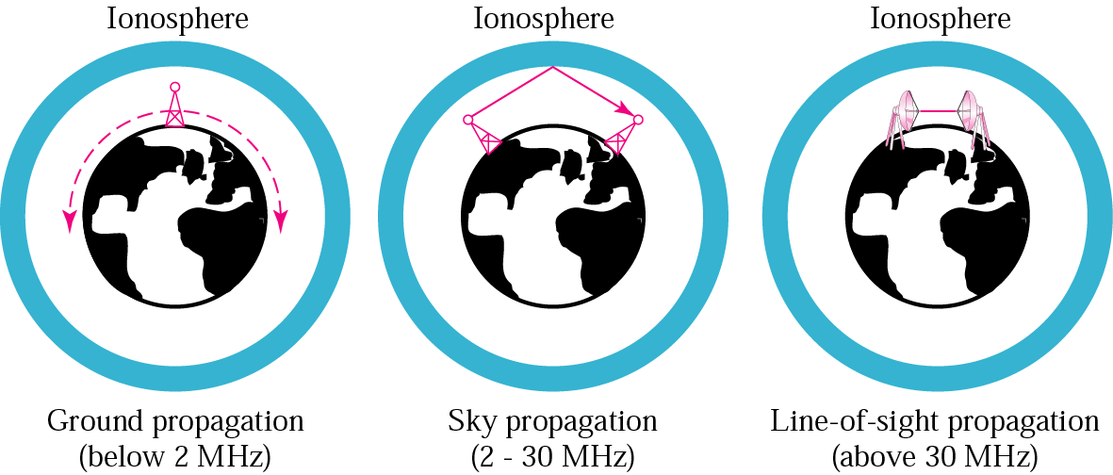
Propagation Methods
Ionosphere is a layer of charged particles circling the earth at a height of 100 to
500km , are refracted by it and sent back to earth.

Slide 96
The Electromagnetic Spectrum
The radio, microwave, infrared, and visible light portions of the spectrum can all be used for transmitting information by modulating the amplitude, frequency, or phase of the waves.
Ultraviolet light, X-rays, and gamma rays would be even better, due to their higher frequencies, but they are hard to produce and modulate, do not propagate well through buildings, and are dangerous to living things

Slide 97
The Electromagnetic Spectrum
LF – Low Frequency
MF – Medium Frequency
HF – High Frequency
VHF – Very HF
UHF – Ultra HF
SHF – Super HF
EHF – Extremely HF
THF – Tremendously HF

Slide 98
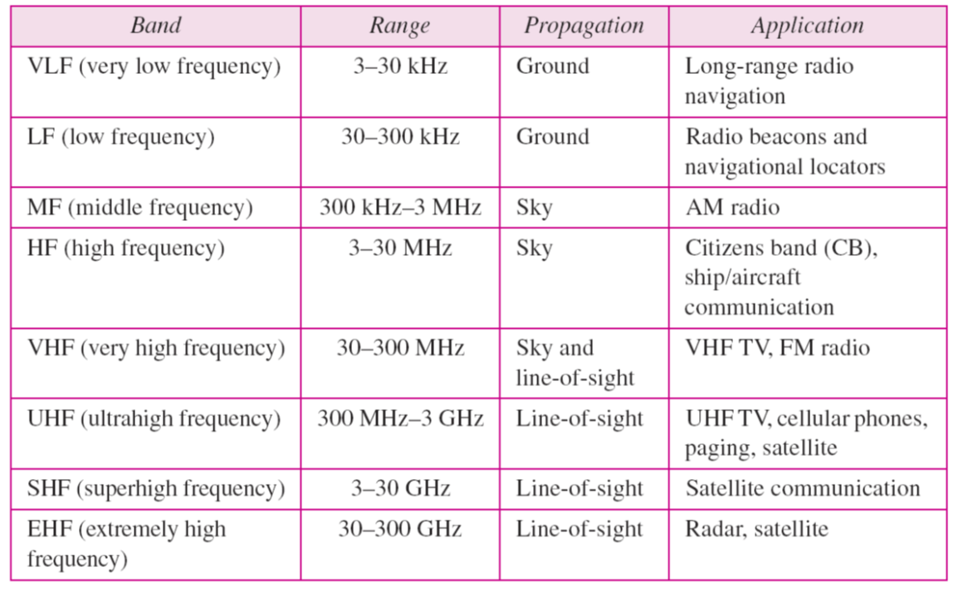
Bands

Slide 99
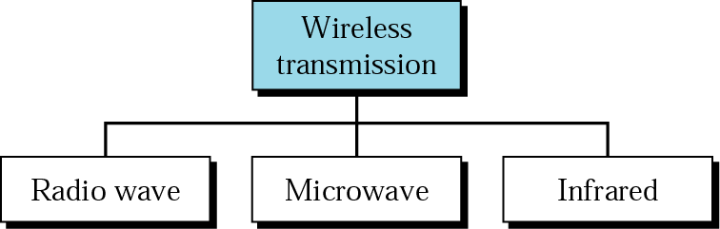
Wireless Transmission Waves

Slide 100
RADIO WAVES
Electromagnetic waves ranging in frequencies between 3KHz and 300GHz are normally called Radio Waves.
Radio waves are used for multicast communications, such as radio and television, and paging systems and Radio waves, for the most part, are omni directional.
They have wavelengths ranging from 1 Mm to 100 Kms.
They have omni directional antennas that send out signals in all directions.
These propagate in the sky mode, can travel long distances.
The omni directional characteristics of radio waves make them useful for multicasting, in which there is one sender but many receivers.

Slide 101
TV channels utilize frequencies in the range of 54 to 88 MHz and 174 to 222 MHz (the entire FM radio band lies between channels 88 MHz and 174 MHz). These TV channels are called VHF (very high frequency).
The TV video signal is AM, while the TV audio is FM.

Slide 102
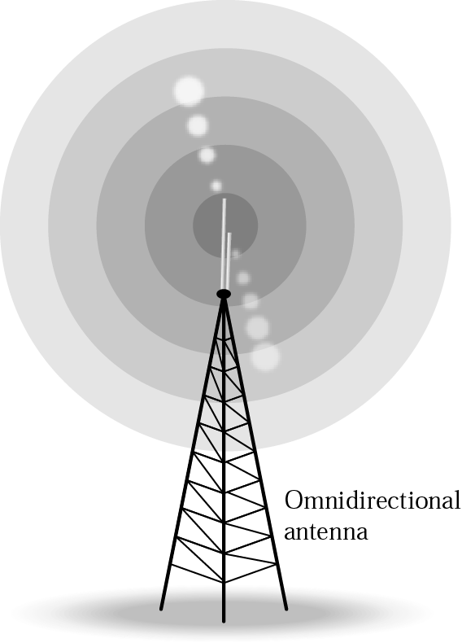
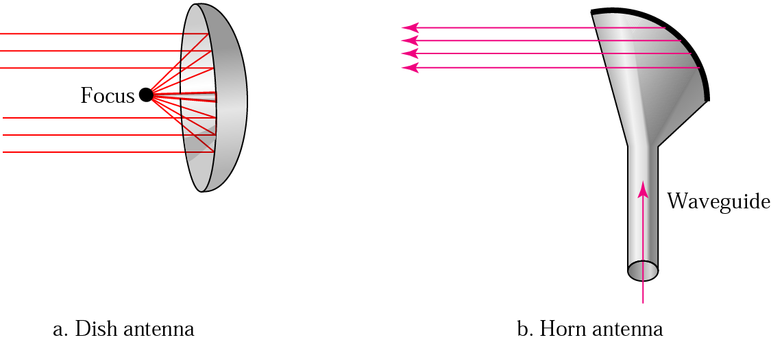
Omnidirectional & Unidirectional Antennas
A horn antenna is used for the transmission and reception of microwave signals. It derives its name from the characteristic flared appearance. The flared portion can be square, rectangular, or conical. The maximum radiation and response corresponds with the axis of the horn.

Slide 103
Microwaves
Electro Magnetic Waves Ranging in frequencies between 300Mhz and 300 GHz are called Microwaves. Microwaves are unidirectional.
They have wave lengths ranging from 1 mm to 1 mt.
Microwaves are widely used in microwave ovens as the resonant frequency of water molecules lies in the microwave region.
Microwaves are used for unicast communication such as cellular telephones, satellite networks, television distribution and wireless LANs
Microwaves are also used in RADARs, astronomy, navigation and spectroscopy.

Slide 104
Characteristics of Microwaves:
Microwaves propagation is line of sight.
Very high frequency microwaves cannot penetrate walls.
The microwave band is relatively wide, almost 299 GHz
Use of certain portions of the band requires permission from authorities.

Slide 105
Radio waves are mostly used in the communication field whereas microwaves are used in industries and astronomy.
Mobile phones, phone mast antennas (base stations), DECT cordless phones, Wi-Fi, WLAN, WiMAX and Bluetooth have carrier wave frequencies within the microwave band of the electromagnetic spectrum, and are pulsed/modulated.
Most Wi-Fi computers in schools use 2.45GHz (carrier wave), the same frequency as microwave ovens.

Slide 106
Infrared
Infrared signals can be used for short-range communication in a closed area using line-of-sight propagation
Infrared Waves, with Frequencies from 300GHz to 400 THz can be used for short range communication.
Having high frequencies, it cannot penetrate walls
IrDA (Infrared Data Association) for standards
Example: IrDA port for wireless keyboard
Originally defined a data rate of 75 kbps for a distance up to 8 m
Recent standard for a data rate of 4 Mbps
Remote controls used on televisions, VCR’s and Stereos

